Slide 1
Attrition Data Analysis

Slide 2
Introduction
This presentation will explore a comprehensive dataset on employee attrition, covering key factors that influence employee retention and turnover within an organization.
The Attrition dataset contains a set of attributes that provide insights into employee demographics, job characteristics, work environment, compensation, career development, and work-life balance. These attributes collectively offer a holistic view of factors that may contribute to employee turnover within an organization.
Demographic factors : Age, Gender, Marital Status
Job-related factors : Job Role, Job Level, Job Satisfaction
Work environment : Department, Distance from Home, Environment Satisfaction
Compensation and Benefits : Monthly Income, Percent Salary Hike, Stock Option Level.
In this dataset I analyzed most of the columns and I used Tableau tool for analyze and visualization . In Tableau, I created different – different charts and dashboards for visualization . Firstly I find the Attrition rate and average salary in different-different categories .After that I created a calculated field i.e. the difference of average salary of Attrition = ‘no’ and average salary of Attrition = ‘yes’ . Then analyzed dataset using different-different Parameters .

Slide 3
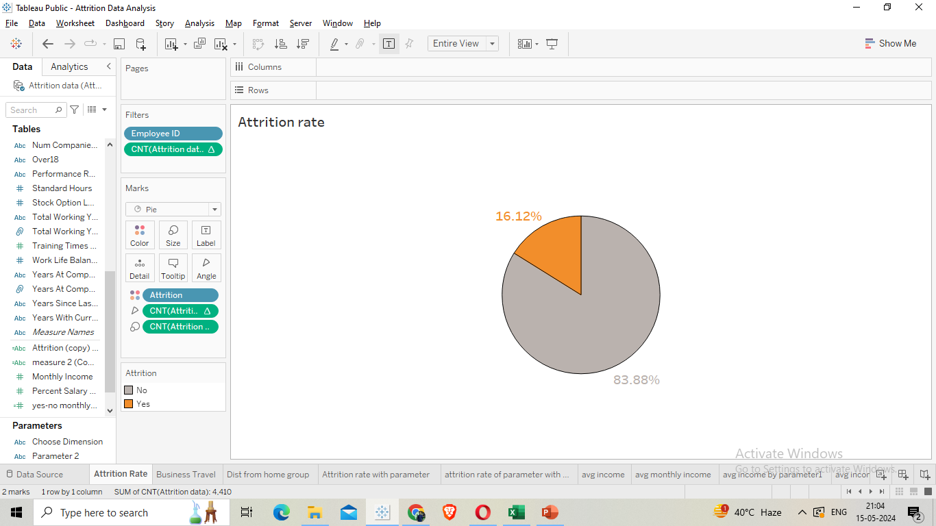
16.12% of the people have left the company.

Slide 4
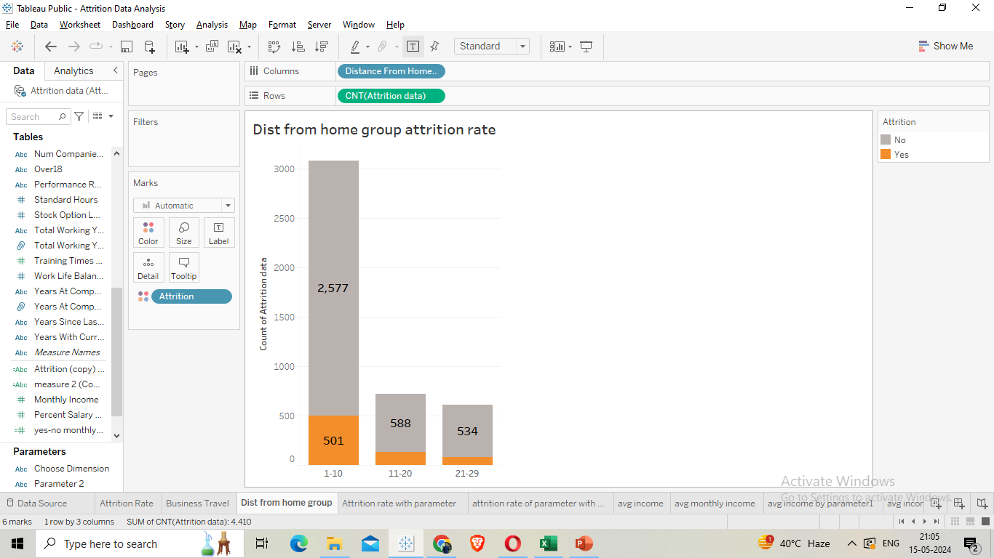
First I create a group of Distance from home . Then I divide the values into 3 groups i.e. 1-10 , 11-20 and 21-29 .Then find the attrition rate and I did not get any much different so there is minimum affect of distance from home .

Slide 5
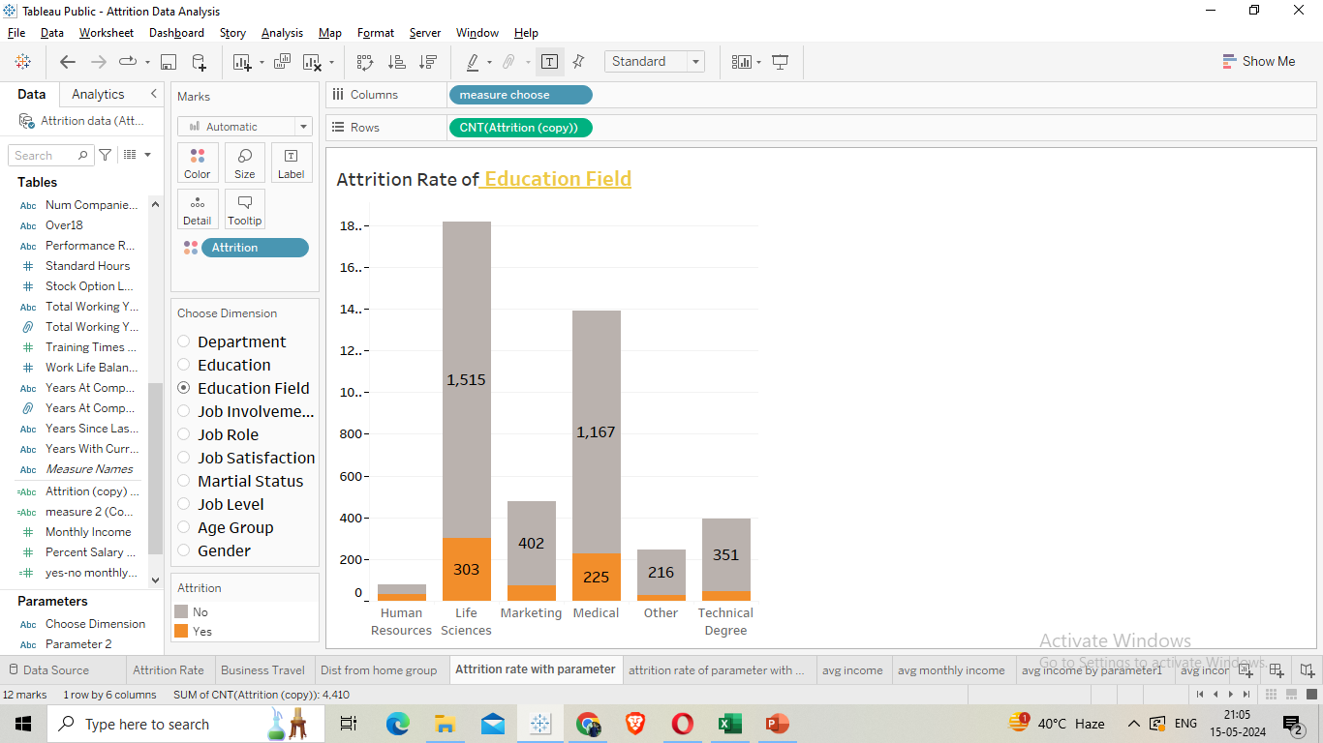
In this chart I used Parameter .By using parameter I can find attrition rate of any given Dimensions . Here in Education Field , the attrition rate is high in Life Science and Medical .

Slide 6
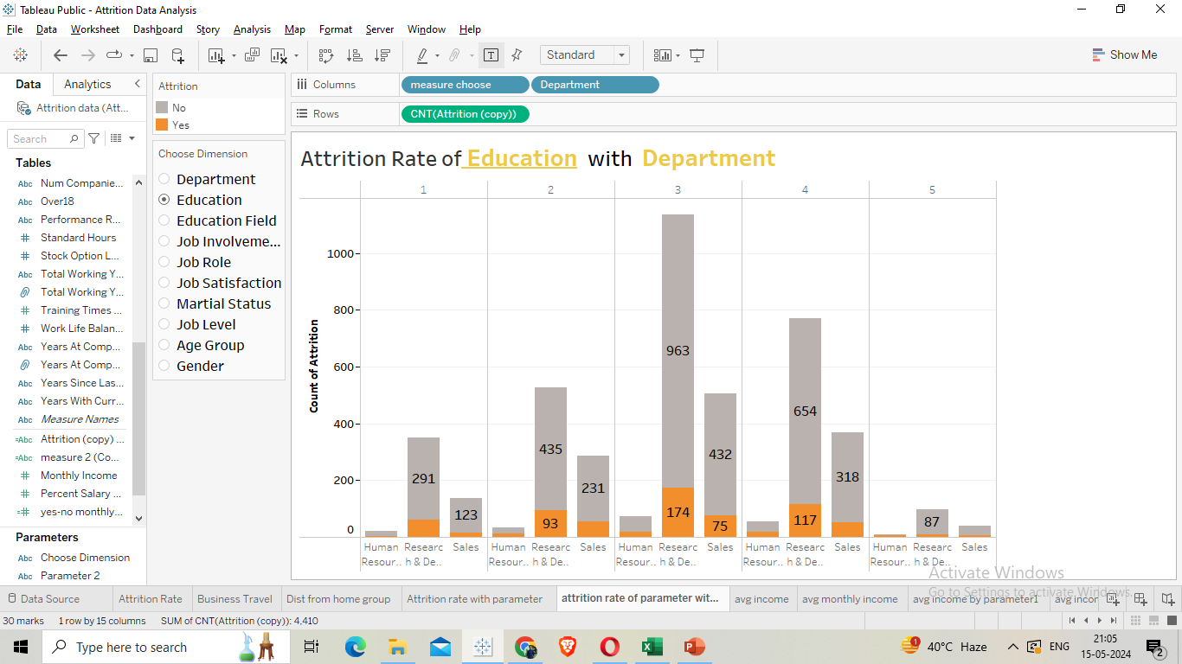
In this chart, I used multiple dimensions. The attrition rate is high in the Research and Development department, particularly among employees with a Bachelor's (3) and Master's (4) degree in education .

Slide 7
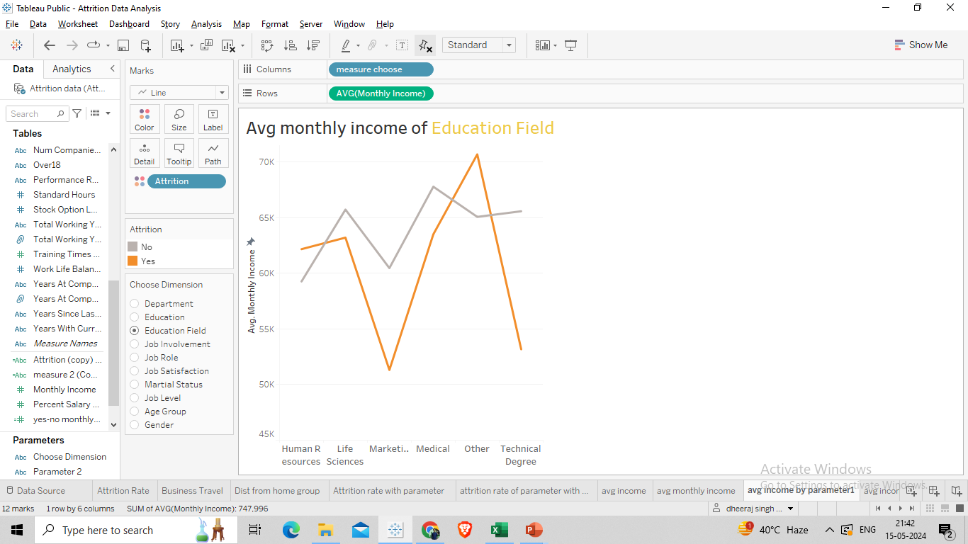
The average monthly salary across nearly every education field tends to be lower when attrition is observed. Particularly in Life Sciences and Technical Degrees, the difference in average salary is notably significant. I employed parameters to assess each dimension comprehensive .

Slide 8
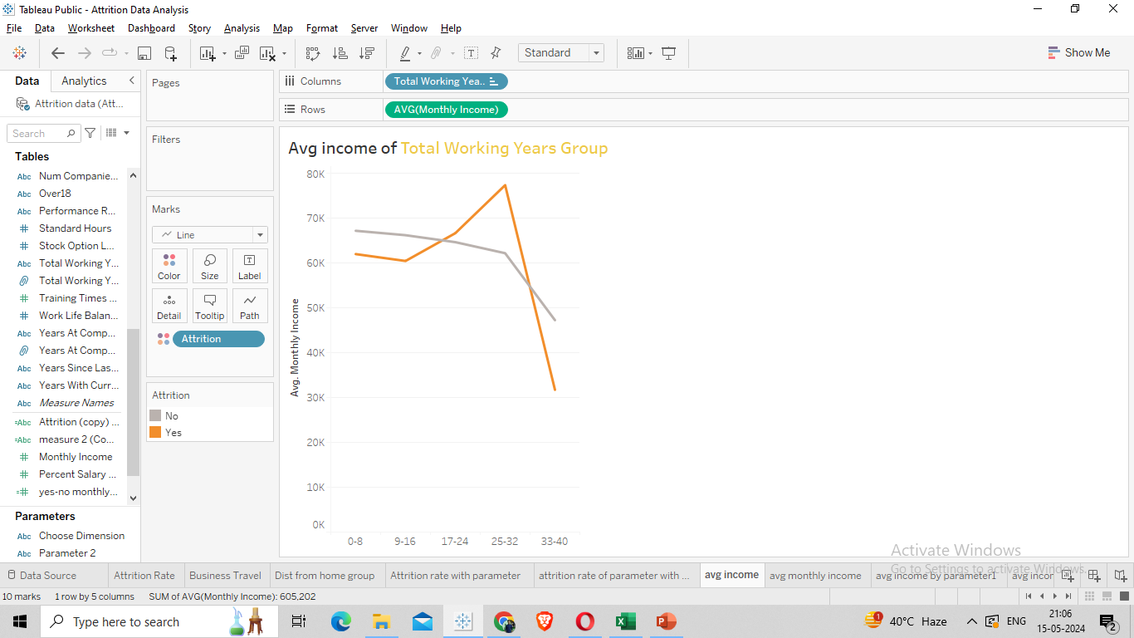
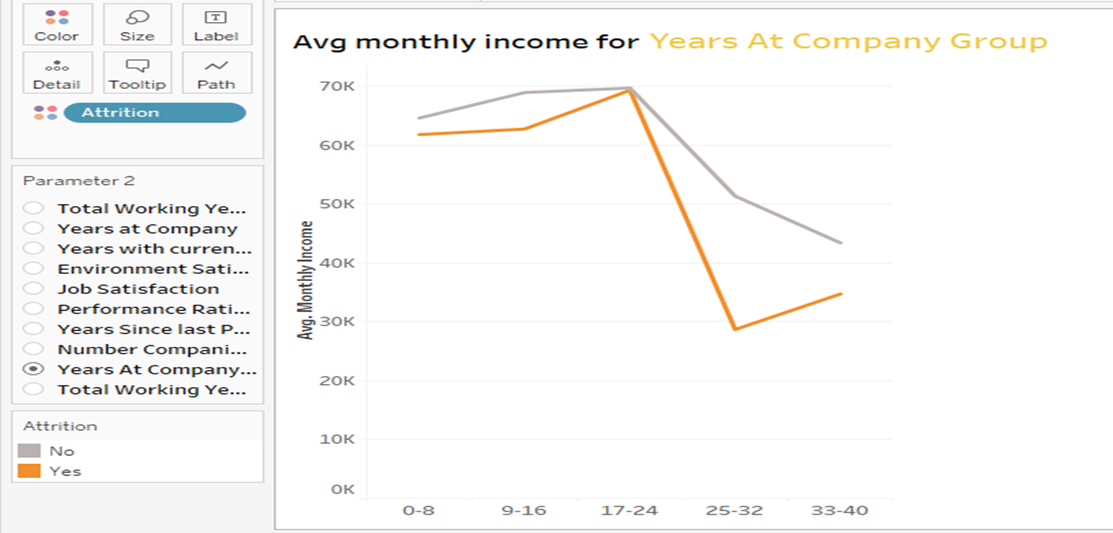
I have divided the Total Working Years and Years at company into 5 groups. Here there are 2 line charts one for Attrition = yes and another for Attrition = no . And we can clearly observed that the Average income for Attrition =‘yes’ is mostly very less compare to Attrition =‘no’ and I used Parameter in second chart. So one of the factors contributing to attrition is the decrease in salary for experienced employees .

Slide 9
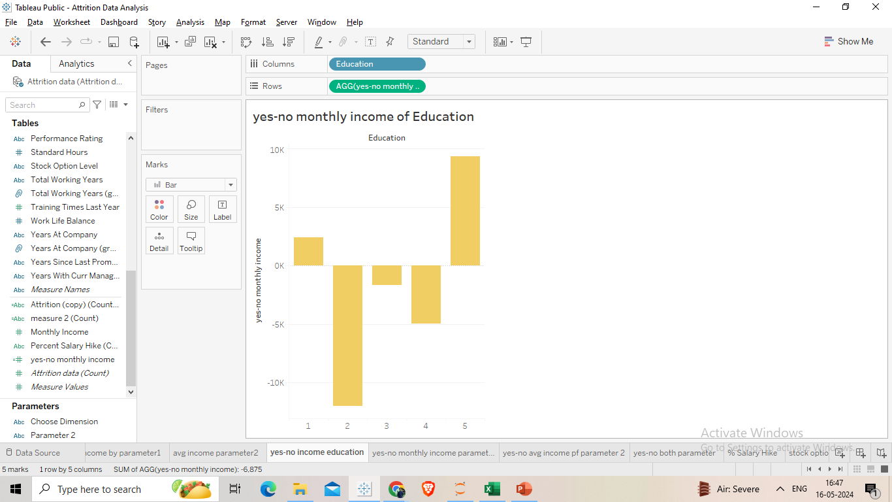
I have created Yes-no monthly income in Create Calculated Field i.e. the difference of average monthly salary of attrition =‘ yes’ and the average monthly salary of attrition =‘no’. If it is negative that indicate that the average salary of attrition =‘yes’ is lower and also tells that how much lower salary. Here ,the difference is due to education. For lower education the salary of attrition=‘yes’ is very less.

Slide 10
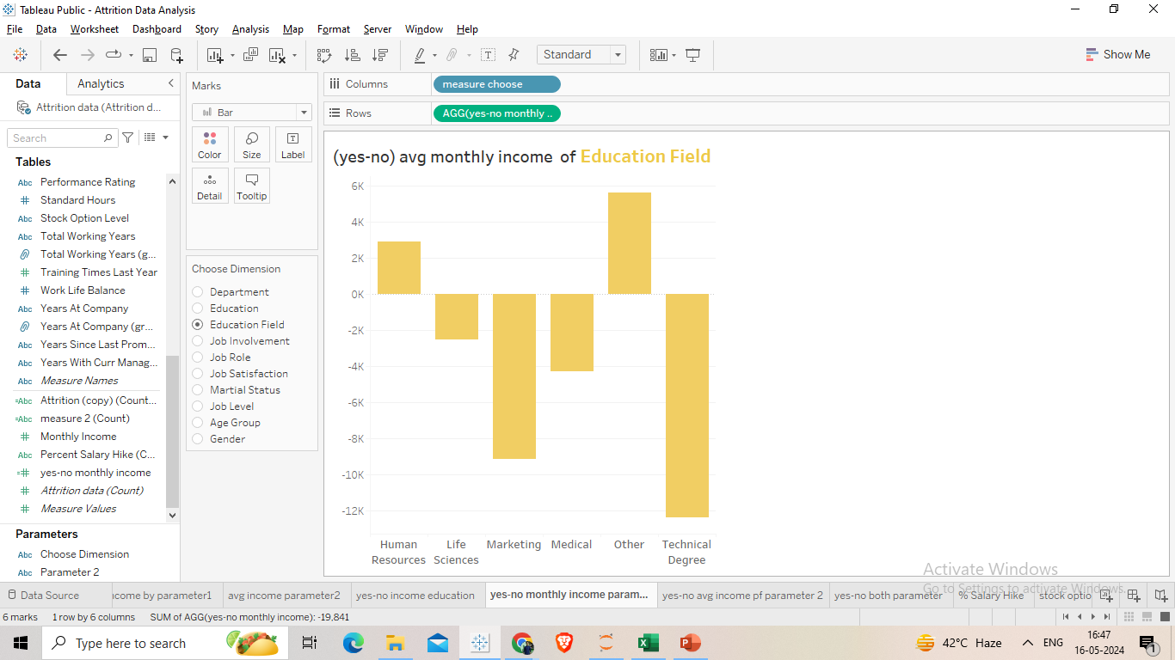
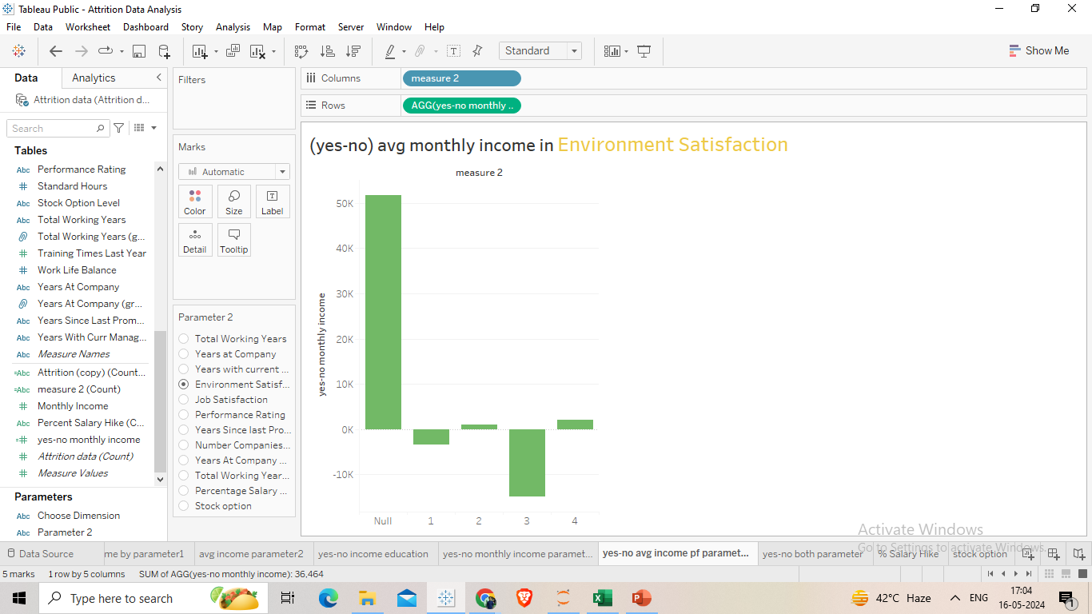
Using parameter finding the (yes-no) avg monthly income . Here I select Education Field and Environment Satisfaction . Marketing and Technical Degree are significantly impacted in Education field and 3 is impacted in Environment satisfaction .

Slide 11
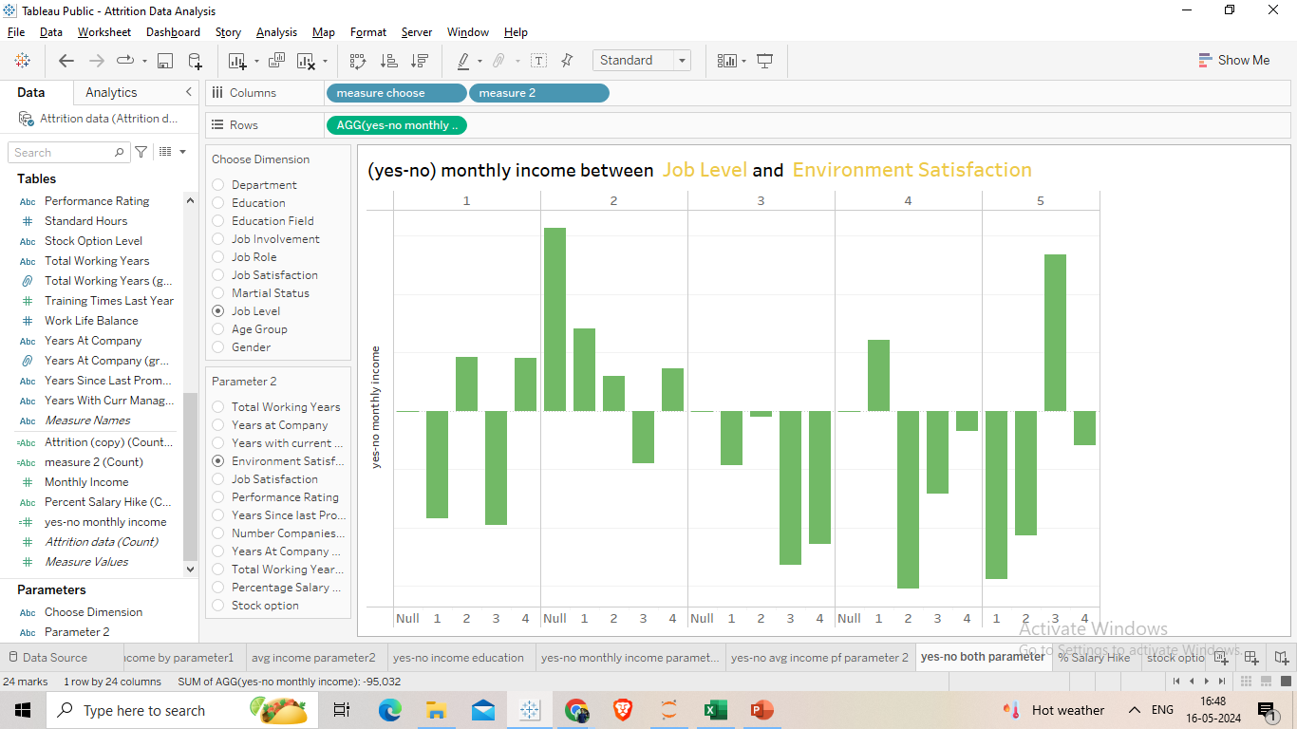
Here I used both the parameter together and analyzed the (yes-no) monthly avg salary.

Slide 12
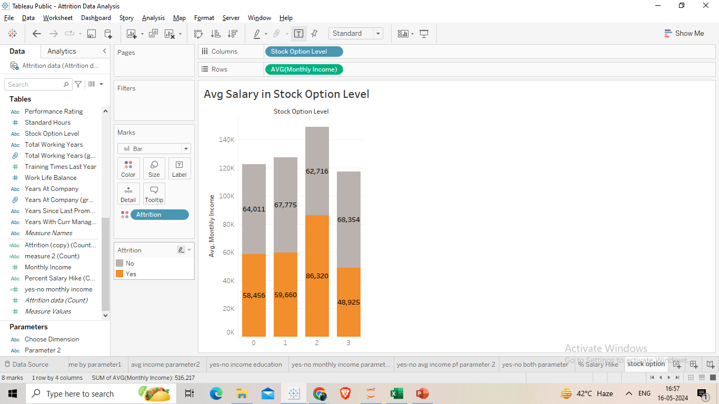
This is the average salary of different Stock Option Level .

Slide 13
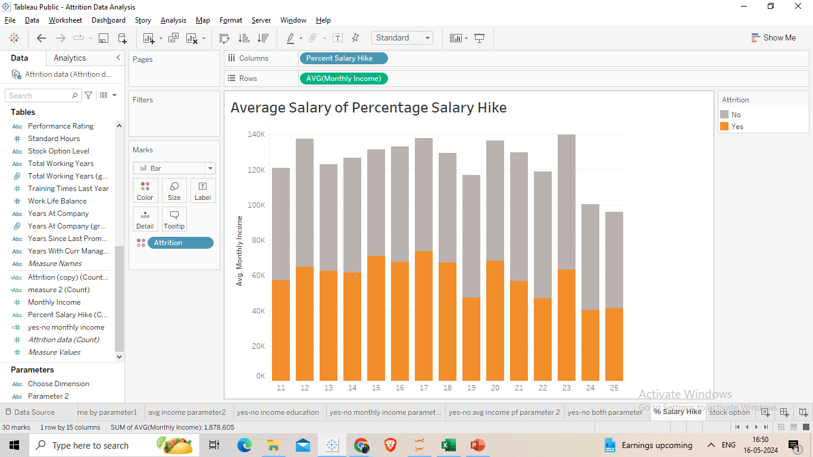
Average Salary of Percentage Salary Hike . Employees with lower percentage salary hikes have the highest attrition rates.

Slide 14
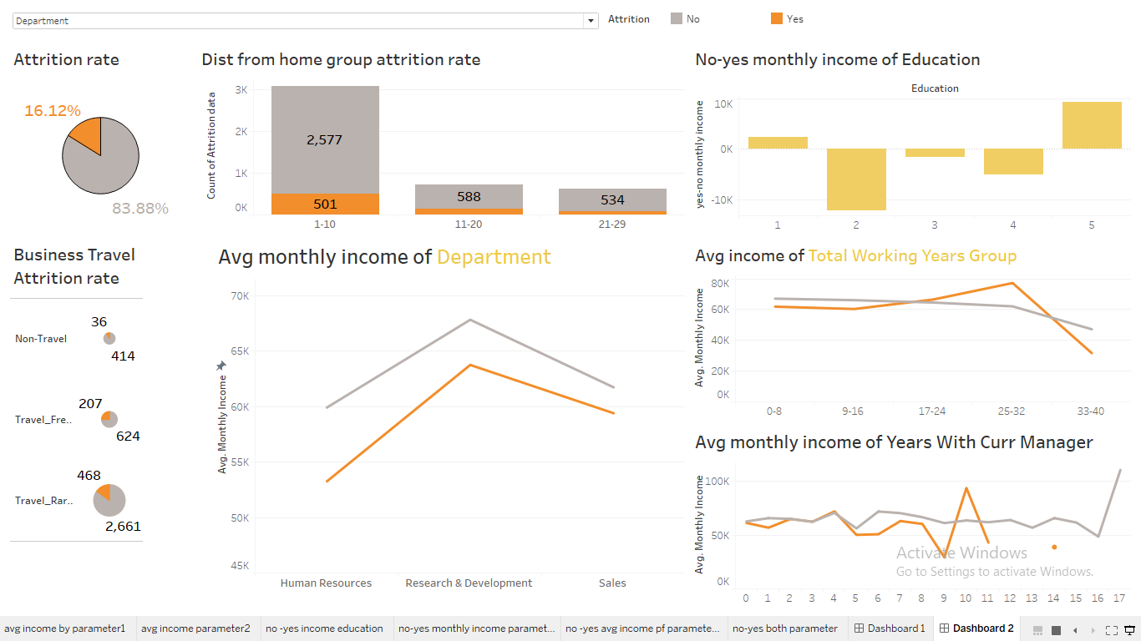
Dashboard 1

Slide 15
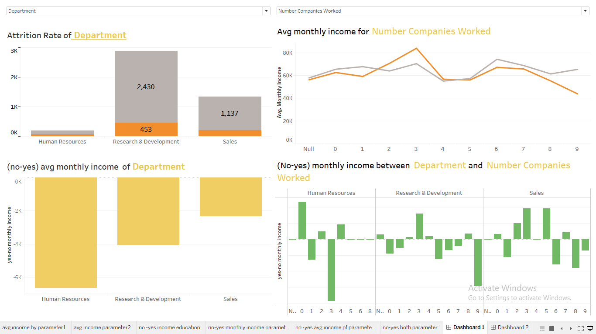
Dashboard 2

Slide 16
Thank you

